Slide 1
Lesson #3
New Data Type - List
For Loop
Building Intelligence in Code
If Else Conditional Statements

Slide 2
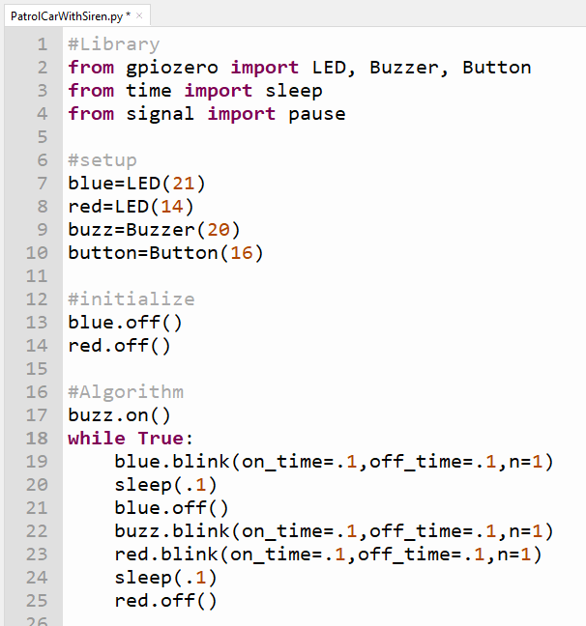
https://www.youtube.com/watch?v=8wsYT1PRjIg
Add siren to your patrol car project

Slide 3
A List is a collection of Data
Like this -> [‘Apple’,’Orange’,’Raspberry’,’Banana’]
We can assign as variable name to it
>>> FruitBasket= [‘Apple’,’Orange’,’Raspberry’,’Banana’]
Index 0 1 2 3
Each item in the List has an index position, starting from 0
>>> print(FruitBasket[0] )
We can change the ‘value’ of an item in the List
e.g. we want to replace ‘Orange’ with ‘Grapes’
>>> FruitBasket[1]=‘Grapes’
>>> print(FruitBasket)

Slide 4
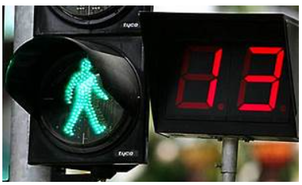
PEDESTRIAN CROSSING – TIME LEFT COUNT DOWN DISPLAY
Please follow me closely

Slide 5
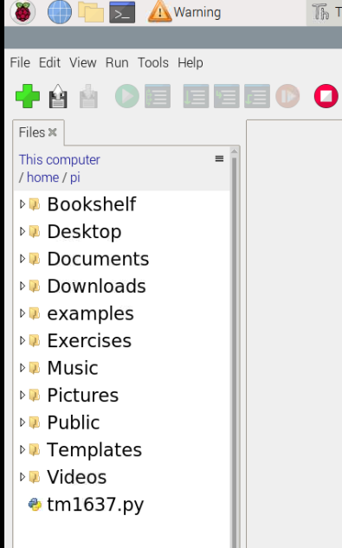
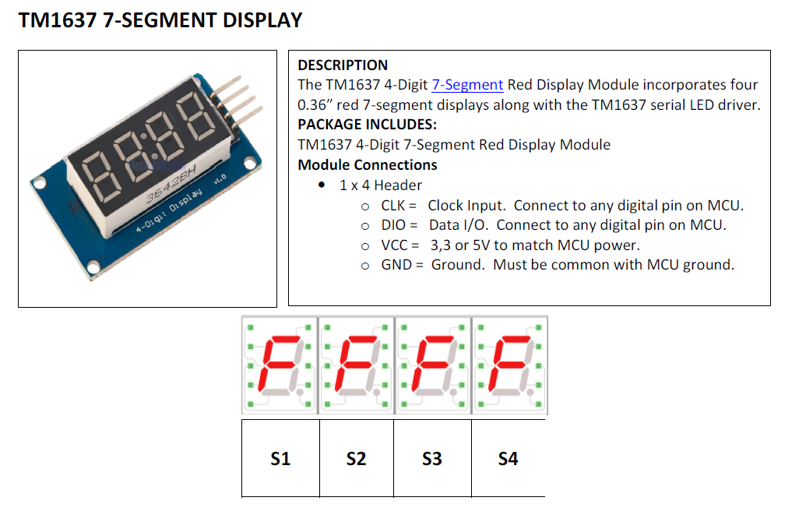
A NEW DEVICE AND A NEW LIBRARY
The 7 Segment Display Library
Segments are controlled by the tm1637.py library

Slide 6
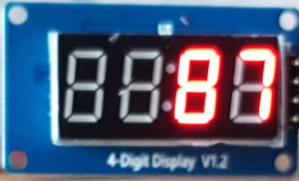
The 7 Segment Display Accepts Data as a List
>>> FruitBasket= [‘Apple’,’Orange’,’Raspberry’,’Banana’]
Index 0 1 2 3
display.set_values([' ', ' ', '8 ', '7'])
0 1 2 3
0 1 2 3

Slide 7
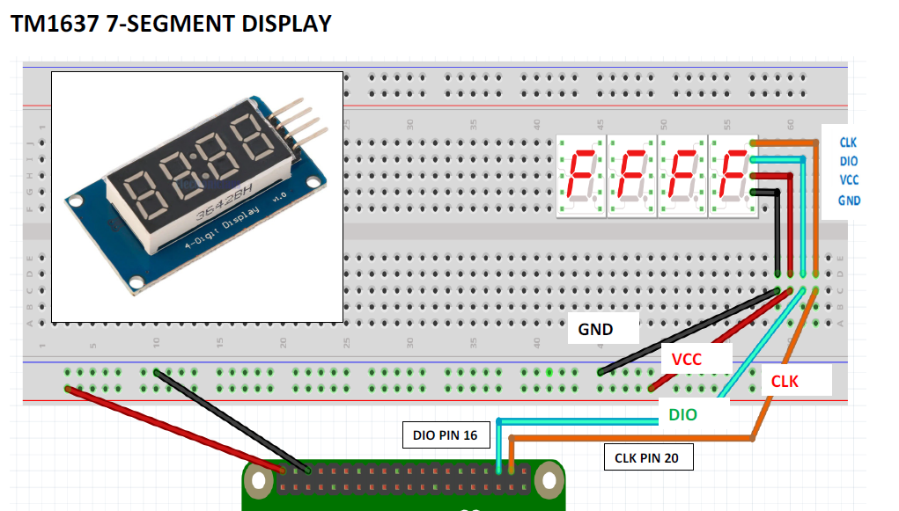
Exercise 4 – Wiring and Testing Count Down Display

Slide 8
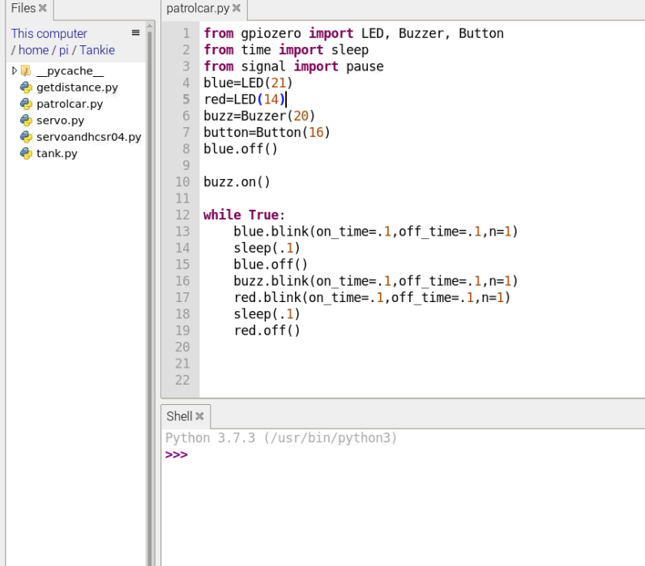
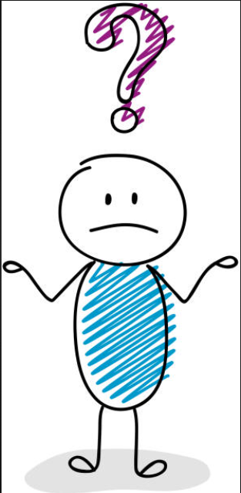
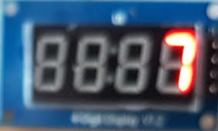
I.D.E Integrated Development Environment
TESTING OUR CIRCUIT USING THONNY SHELL >>>
Ex 4a
>>> import tm1637
>>> display = tm1637.TM1637(20, 16)
>>> #20=CLK 16=DIO
>>> display.clear()
>>> display.set_values([' ', ' ', ' ', '7'])
Editor
File
Explorer
Ex 4b
>>> display.clear()
>>> display.set_values([' ', ' ', '8 ', '7'])
Ex 4c
How do you display 1234
Or HELP?
Shell

Slide 9
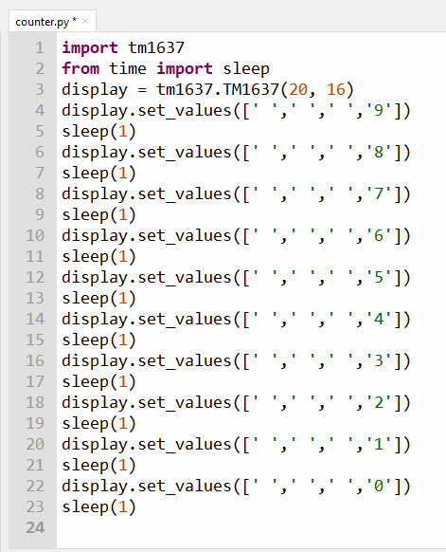
Making the 7 Segment Display Library takes the display
Data as a List
[ ' ', ' ' , ' ', '9']
[ ' ', ' ' , ' ', '8']
[ ' ', ' ' , ' ', '7']
[ ' ', ' ' , ' ', '6']
[ ' ', ' ' , ' ', '5']
[ ' ', ' ' , ' ', '4']
[ ' ', ' ' , ' ', '3']
[ ' ', ' ' , ' ', '2']
[ ' ', ' ' , ' ', '1']
[ ' ', ' ' , ' ', '0']
The data to be displayed is sent to the function in the library display.set_values
At 1 seconds intervals in this case

Slide 10
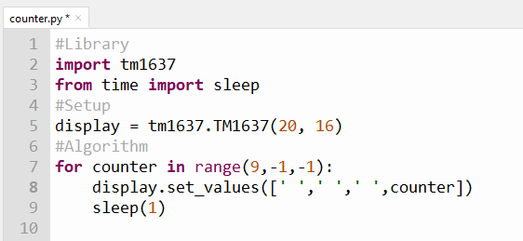
Introduction to the Python For Loop
This value is changing from 9 to 0
Create a variable
to represent this value
We give it a name called counter
USE A for LOOP

Slide 11
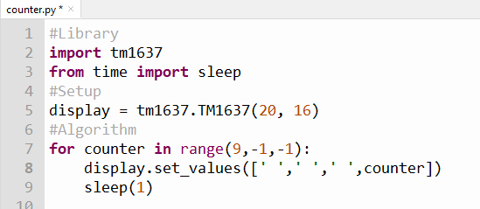
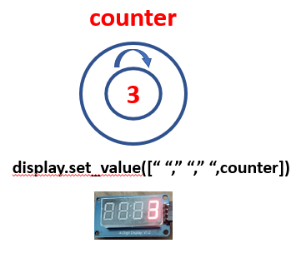
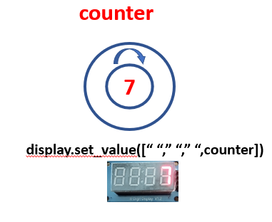
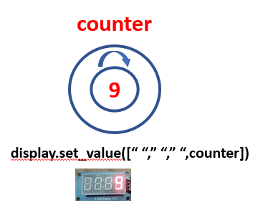
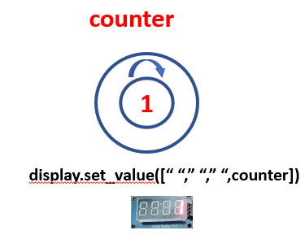
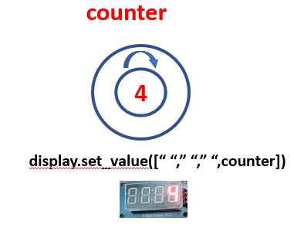
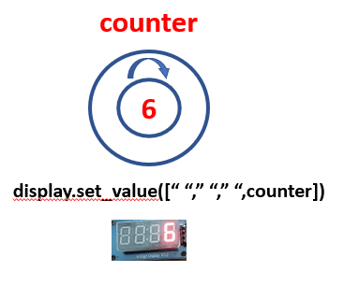
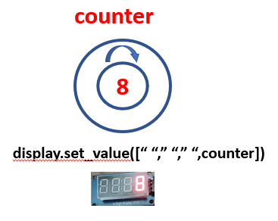
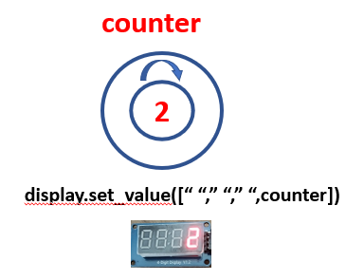
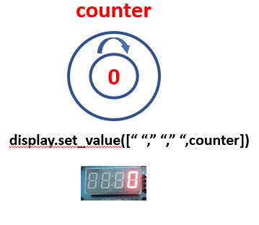
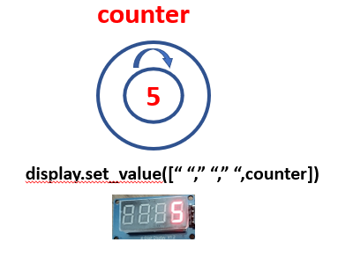
The FOR LOOP

Slide 12
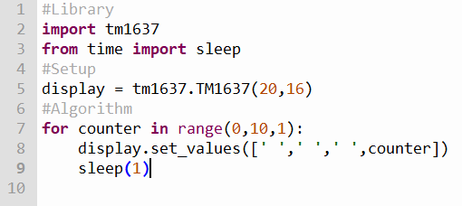
Counting from 0 to 9 in step of 1

Slide 13
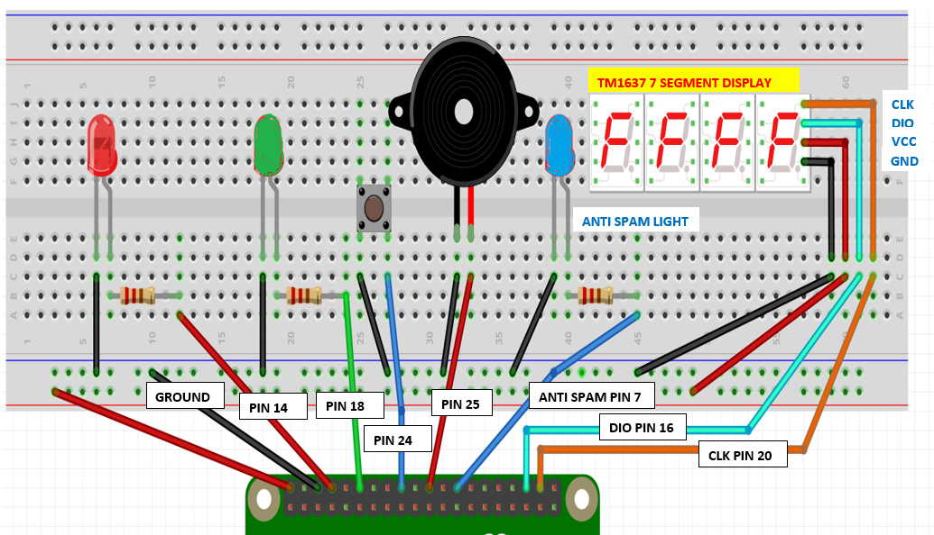


Exercise 5 – Wiring Pedestrian Crossing with Anti Spam LED and Count Down Display

Slide 14
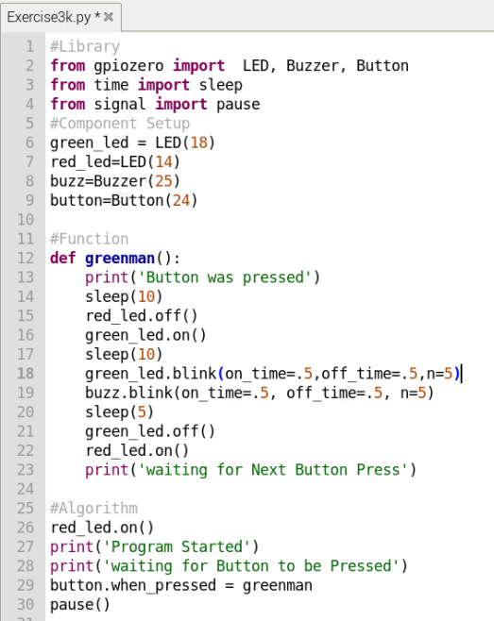
Putting everything we have learned together into a full fledged pedestrian crossing
Recap our Algorithm and Code for earlier version
ALGORITHM FOR A PEDESTRIAN CROSSING
STARTS WITH RED ON
WHEN BUTTON IS PRESSED
ACTIVATE Function greenman()
Now we want to add the Countdown here as well

Slide 15
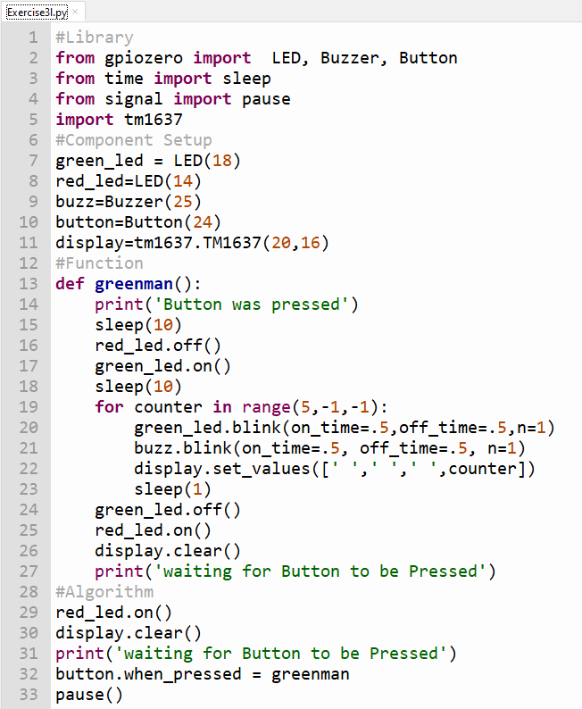
Injecting codes for countdown display
for counter in range(5,-1,-1):
green_led.blink(on_time=.5,off_time=.5,n=1)
buzz.blink(on_time=.5,off_time=.5,n=1)
sleep(1)
for counter in range(5,-1,-1):
green_led.blink(on_time=.5,off_time=.5,n=1)
buzz.blink(on_time=.5,off_time=.5,n=1)
sleep(1)
Now we want to add the Countdown here as well

Slide 16

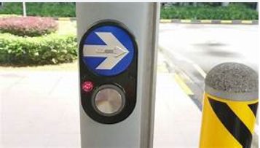
Exercise 5 – Wiring Pedestrian Crossing with Anti Spam LED and Count Down Display

Slide 17
def greenman():
print('Button was pressed')
sleep(10)
red_led.off()
green_led.on()
sleep(10)
for counter in range(5,-1,-1):
green_led.blink(on_time=.5,off_time=.5,n=1)
buzz.blink(on_time=.5, off_time=.5, n=1)
display.set_values([' ',' ',' ',counter])
sleep(1)
green_led.off()
red_led.on()
display.clear()
anti_spam_led.off()
print('waiting for Button to be Pressed')
#Algorithm
red_led.on()
anti_spam_led.off()
display.clear()
print('waiting for Button to be Pressed')
button.when_pressed=activate
pause()
Adding Check for Anti Spamming Exercise3m.py
#Library
from gpiozero import LED, Buzzer, Button
from time import sleep
from signal import pause
import tm1637
#Component Setup
green_led = LED(18)
red_led=LED(14)
anti_spam_led = LED(7)
buzz=Buzzer(25)
button=Button(24)
display=tm1637.TM1637(20,16)
#Function
def activate():
if anti_spam_led.value==1:
pass
else:
anti_spam_led.on()
greenman()

Slide 18
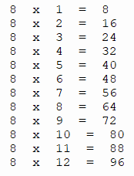

For Loop in Times Table
Can you do times table for the other numbers?

